Slide 1
Blood Donation
Management
Simona Dilovska

Slide 2
Table of Contents
Purpose of the Project
Database Tables
Creation Process
Questions?

Slide 3
Purpose of the Project

Slide 4
Idea
Mission
The idea of the project is to investigate the process of creating a database for purpose. I had to create a database for a client in order for them to efficiently store and manage data and information. I chose to work on blood donation management.
I created a database with all the information that blood banks need in order operate efficiently and have easily accessible information. I have created it in a way to contain all the needed information not only for donors, but also for patients and staff members.

Slide 5
Creation Process

Slide 6
The process
Thinking and planning of the tales and all of the information I needed to store
Visualization in Lucidchart → making the connections between the tables
Writing the code
Insert dummy data to test code
Fixing errors
Making sure my ERD diagram matches the SQL diagram
Complete the project
Create a presentation to show the client

Slide 7
SQL Commands
SELECT - selects data and allows for group modification or presentation
CREATE - creating databases and tables
ALTER - change data in an already existing database
DROP - deleting certain data
INSERT - insert new data
PRIMARY KEY - for distinguishing records in a certain table
FOREIGN KEY - connects different tables
UPDATE - change an already existing database
INNER JOIN - join two tables together through a column that they both have
LEFT JOIN - join two tables together. However it joins the whole first table and only parts of the second one

Slide 8
Database Tables

Slide 9
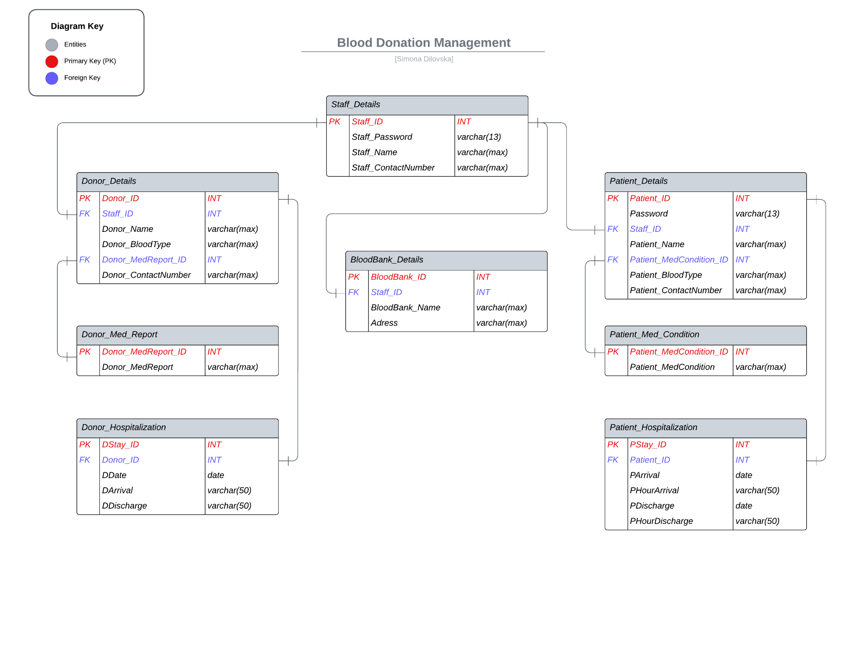

Slide 10
Questions?

Slide 11
Thanks!

